Slide 1







Spark XML Parser
Pooja Nayak
Vikrant Deshpande
Kapil Chouhan
Atanu Ghosh

Slide 2
Business Need and Solution
XML based data source is increasingly becoming a trend which opens a potential avenue for an Accelerator that can consumes XML source, parse it and store it so that it can be conveniently consumed in a common Data Lake architecture. This can be used as a plug-and-play with minimal or no change across multiple projects.
Some of the key areas that led to design and development of this accelerator are:
Business need is to extract required information from semi-structured data like XML format data.
XML (Extensible Markup Language) format is used to structure data so that it can be stored and transported.
Reading of such semi-structured data and getting useful information out of it is a bit complex.
Hence Spark-XML and Spark-CSV library from Databricks is used to simplify this process of parsing XML data.
Spark-Excel library from Crealytics is also being used to read configuration file which is in excel format.
XML Parser using Spark uses Spark-XML library package to read and parse input XML files.
Spark dataframes are used to process this data.
Finally Spark-CSV library package is used to store the output data in required format.

Slide 3
XML/XSD Flask Application
This Flask app with an easy-to-use frontend allows a user to generate the config excel file for Pyspark ingestion
After logging into the application, one must upload an XML/XSD File, select a file-format, a destination data delimiter (default: comma), and a filename for the final config file (default: original filename with timestamp)
The actual hierarchy of XML/XSD selectable tags is now displayed and one needs to choose a section of these tag(s), and enter the Primary key tag, Primary child tag, and Primary parent tag
Finally, the config excel file for the parsed XML/XSD Tags is created, so that the Spark-Scala code can access and read the XML files from Unix directory
1
User logs in
successfully
2
Upload file and provide metadata
3
Choose section of nested tags
5
Config.xlsx file is generated
4
App parses the selected tags

Slide 4



Spark XML Architecture
The proposed architecture will consume XML files from Unix location.
The required parameters such as Source Location, Destination Location, Output Data Delimiter, Primary Key etc. will be fetched from the config file.
The data will then be cleansed and processed using Spark-Scala and finally loaded into a Unix or S3 location.
Current Sources
Current Destinations
Config file
MySQL Audit Table
Output files
Read Config file
Read XML files
Extract and process data using
Spark-Scala
Store Output file
XML files
Unix
directory
Output files
Unix
directory

Slide 5
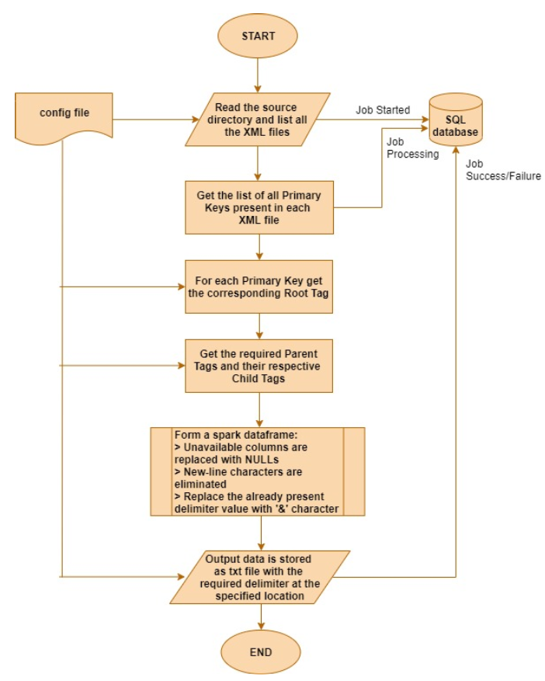
Spark XML Parser Workflow
The config file must be pre-loaded with required data such as Source Path, Destination Path, Data Delimiter, Primary Parent and Child Tags, Audit Table details.
This config file will be consumed by the XML Parser code.
From the source path all the XML files are read one by one for processing.
In each XML file the list of distinct primary keys are captured.
For each primary key the corresponding Root Tag is fetched from the config file and the XML data is ready for parsing.
The required parent and their child tags are fetched from the config file for extraction.
Spark dataframe is created from the extracted data.
Columns or Tags which are not found are replaced with null values.
Data is cleansed for new-line characters, output delimiter character which are already present are replaced.
The final dataframe is stored into a destination location such as Unix directory or S3 bucket.
The output data will be in the form of txt/parquet files with the specified delimiter.
Auditing of the job status and timings is maintained using an SQL table.

Slide 6
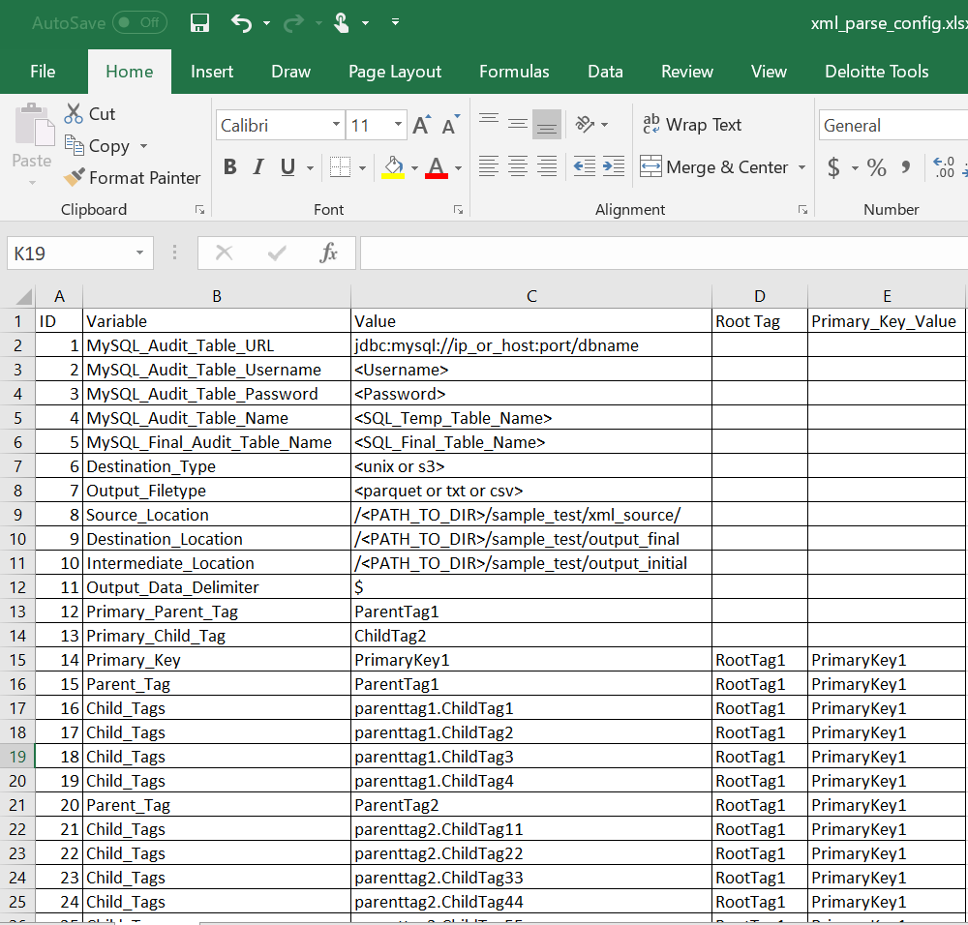
Config File
A single config file in excel format is being used for parsing XML data.
The excel file contains 5 columns : ID, Variable, Value, Root_Tag, Primary_Key_Value
The Variable column contains key variables such as: MySQL_Audit_Table_URL,MySQL_Audit_Table_Username,MySQL_Audit_Table_Password,MySQL_Audit_Table_Name,MySQL_Final_Audit_Table_Name, Source_Location, Destination_Location, Destination_Type, Output_Filetype, Output_Data_Delimiter, Primary_Parent_Tag, Primary_Child_Tag, Parent_Tag, Child_Tags, etc.
The Value column contains values such as: source path for XML files, destination path for loading final output files, intermediate location for storing part files generated, destination type whether Unix/S3, output filetype whether parquet or txt or csv, Primary Parent Tag value, Primary Child Tag value, required Parent Tags and their respective Child Tags, Audit table configurations etc.
The Primary_Parent_Tag and Primary_Child_Tag values are unique and fixed.
Only 1 value can be present in these columns.
The Root_Tag column is used to parse XML data. For a particular data set, the corresponding Root_Tag value and Primary_Key_Value must be specified.
The Destination_Type value must either be Unix or S3 only.
The Output_Filetype value must be either parquet or txt or csv only (case sensitive).
When specifying the Child_Tags, the format is: Parenttag1.ChildTag1. The Parent_Tag and Child_Tag as present in the input XML file.

Slide 7
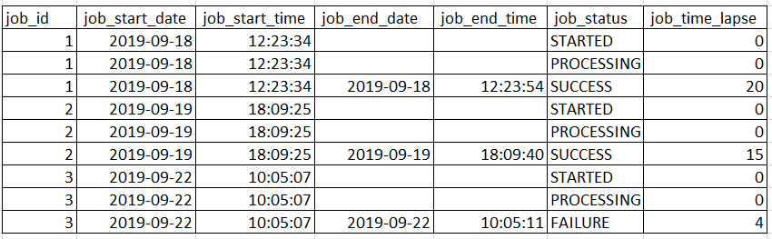
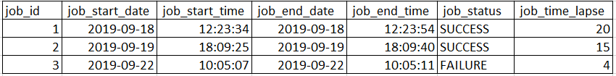
Audit Table
MySQL Table has been used for auditing purpose.
The credentials required to connect to the MYSQL server must be provided in the Config file.
There are 2 Audit tables being used : Temp table and Final Table
Both the Audit tables will have 7 columns each for tracking the status of the XML Parser job. Columns: job_id, job_start_date, job_start_time, job_end_date, job_end_time, job_status, job_time_lapse.
The insertion of records into Audit tables will be done within the XML Parser.
The Temp table will have all the statuses of job and the Final table will have only the final status of the job.
The status at the start of the job : STARTED The status at the mid of job : PROCESSING The status at the end of the job : SUCCESS/FAILURE
The time taken for completing the job is calculated in seconds and loaded in job_time_lapse column.
The Audit tables must be created before in hand.
Temp Audit Table
Final Audit Table

Slide 8
Technical and Environment Details
Spark is used for reading and parsing XML format data.
Scala has been used as coding language.
Databricks library has been used for reading, parsing XML files and storing data in csv format.
Crealytics library has been used to read excel format config files.
Command to run the Spark XML Parser: spark-submit --deploy-mode client --executor-cores 5
--num-executors 2
--driver-class-path <mysql_connector_java_jar>
--conf "spark.authenticate=false" --conf "spark.authenticate.enableSaslEncryption=false"
--packages com.databricks:spark-xml_2.10:0.4.1,com.databricks:spark-csv_2.10:1.5.0,
com.crealytics:spark-excel_2.10:0.8.3
--class "com.XMLParser.Impl.XMLReader"
/path_to_jar/Spark_XML_Parser_ver1-0.0.1-SNAPSHOT.jar
/path_to_config_file/xml_parse_config.xlsx
Spark and Scala versions used:
Spark : 1.6.0
Scala : 2.10.5
Java : 1.8

Slide 9
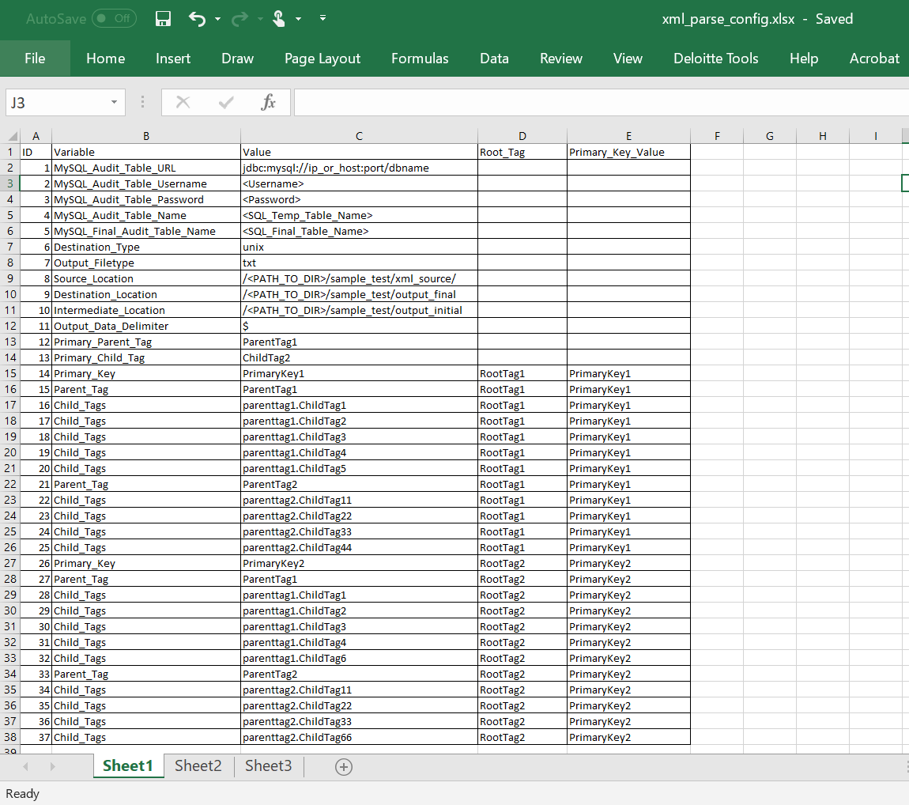
Appendix
Config File

Slide 10
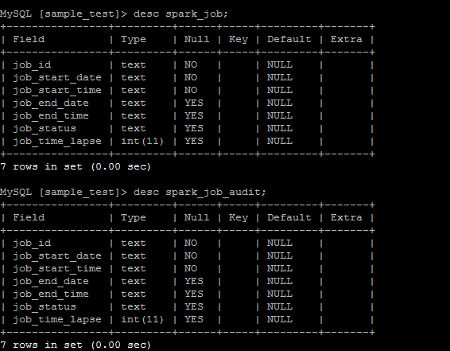
Appendix
Audit Table structure

Slide 11
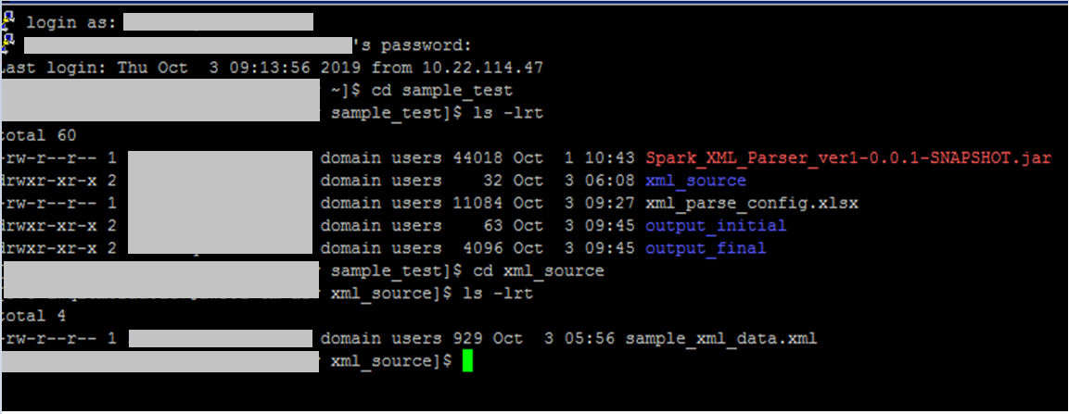
Appendix
Source Unix directory

Slide 12
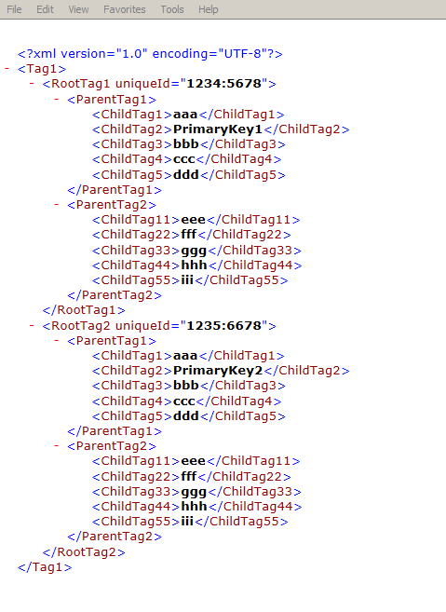
Appendix
Input XML file

Slide 13
Appendix
Spark-submit command

Slide 14
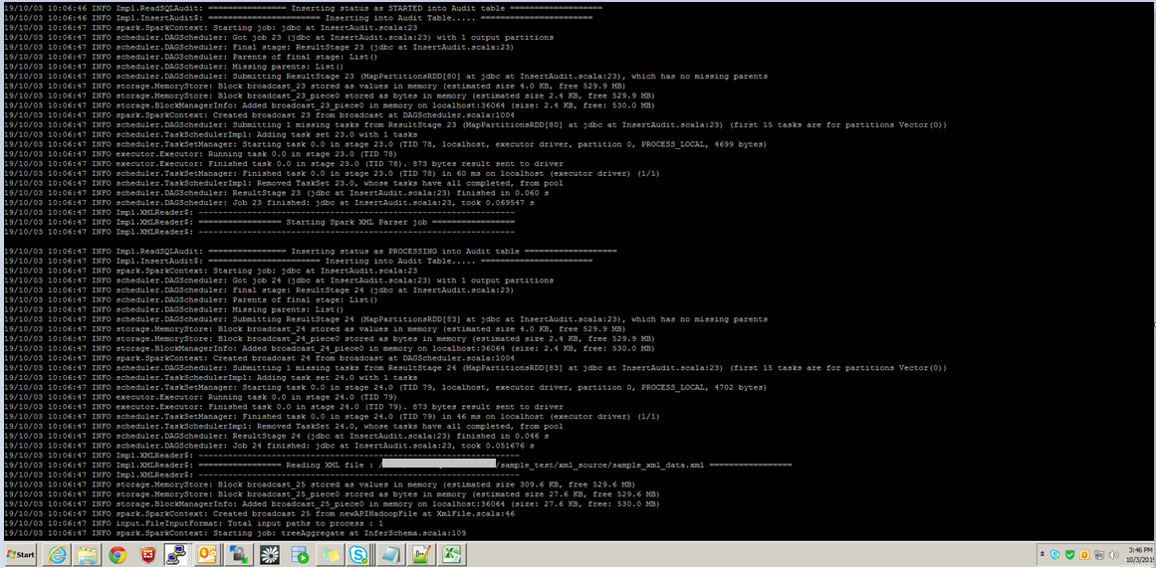
Appendix
Spark Job start

Slide 15
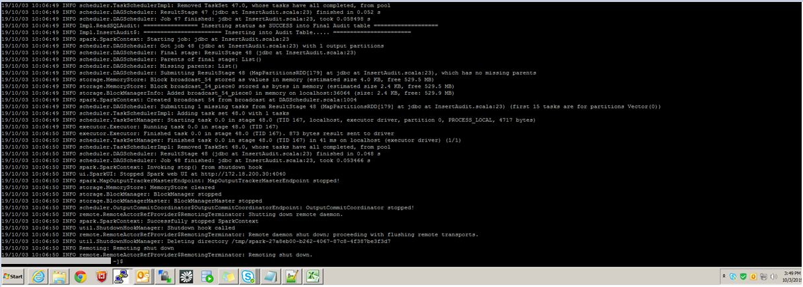
Appendix
Spark Job end

Slide 16
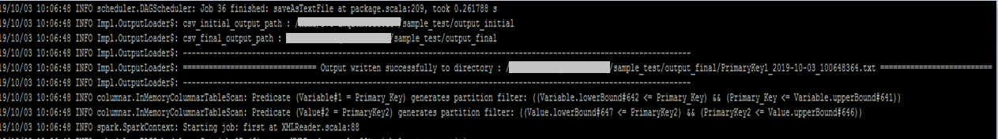
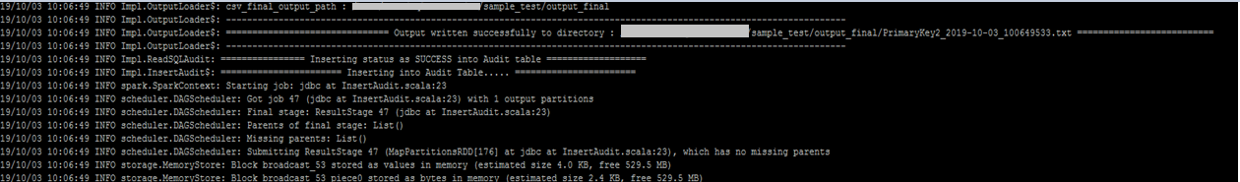
Appendix
Output txt file 1
Output txt file 2

Slide 17
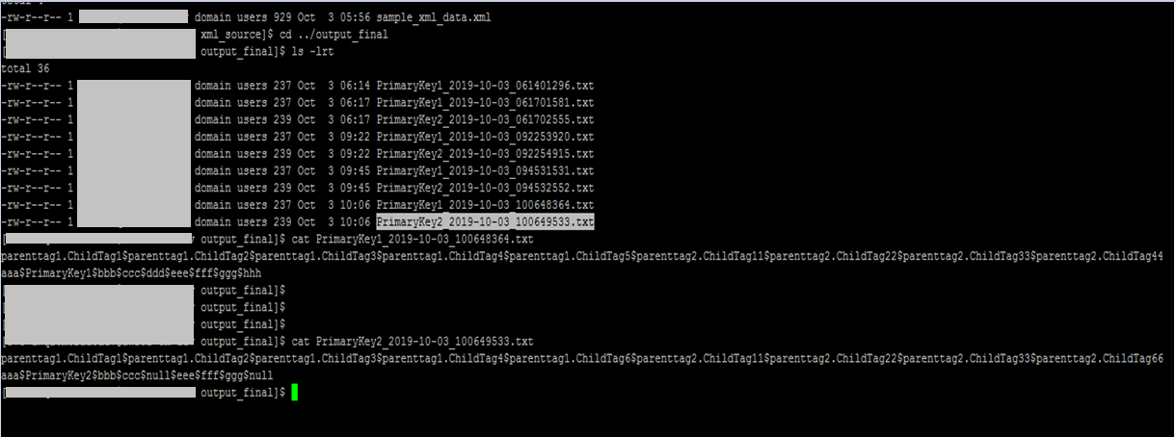
Appendix
Output txt data

Slide 18
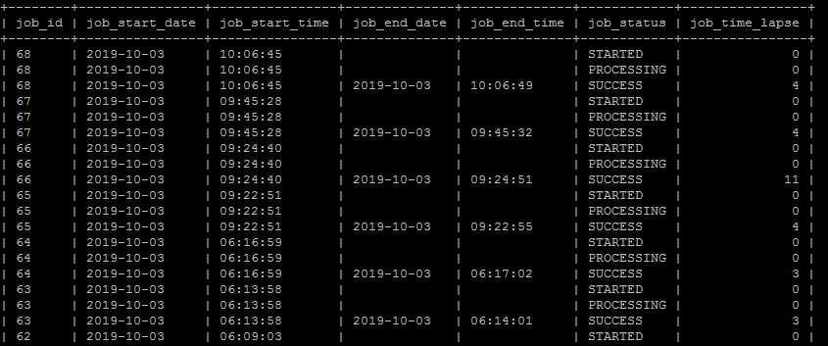
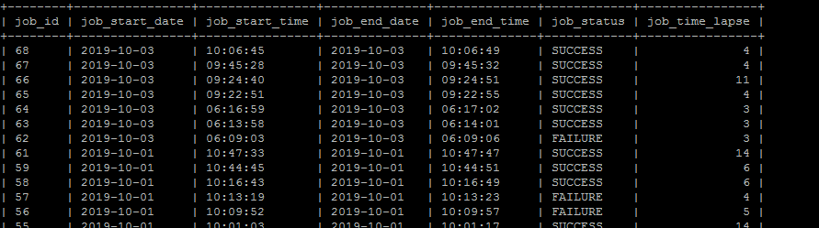
Appendix
Temp Audit Table
Final Audit Table

